Slide 1
Spring Framework

Slide 2
What is Spring?
Spring is a lightweight dependency injection and aspect-oriented container and framework.

Slide 3
Spring Benefits
Lightweight
Dependency Injection
Aspect-oriented
Container
Framework

Slide 4
Spring in N tier Applications
Presentation
Layer
Service Layer
Data
Access
Layer
Spring
Layer
Other
Layers

Slide 5
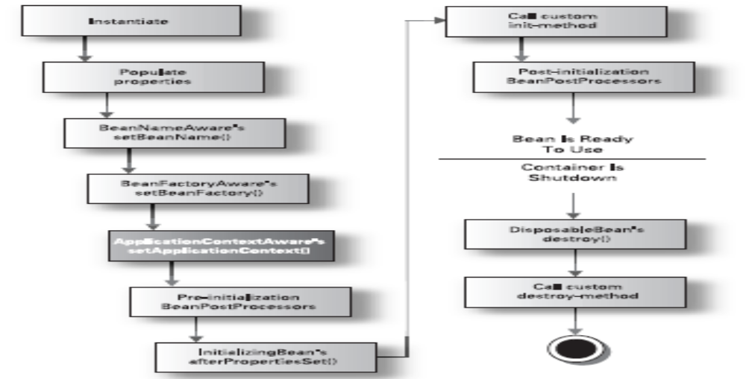
Bean Lifecycle

Slide 6
Creating Beans
Declaring a simple bean
Injecting through constructors
Injecting into bean properties
Autowiring

Slide 7
Controlling bean creation
Bean scoping
Creating beans from factory method
Initializing and destroying beans

Slide 8
Advanced bean wiring
Declaring parent and child beans
Applying method injection
Injecting non-Spring beans
Registering custom property editors
Spring’s special beans
Scripting beans

